Slide 1

Topic: Introduction to OB
Dr. C. Vijaya Banu
Professor , School of Management
SASTRA Deemed University, Thanjavur – 613 401

Slide 2
Learning Objectives
Learners can understand
Meaning of organizational behavior (OB)
The major characteristics of the organizational behavior

Slide 3
Introduction
Study of Organizational Behaviour (OB) is very interesting and challenging
No two individuals are likely to behave same
Human factor that is contributory to the productivity
Situational factors interact

Slide 4
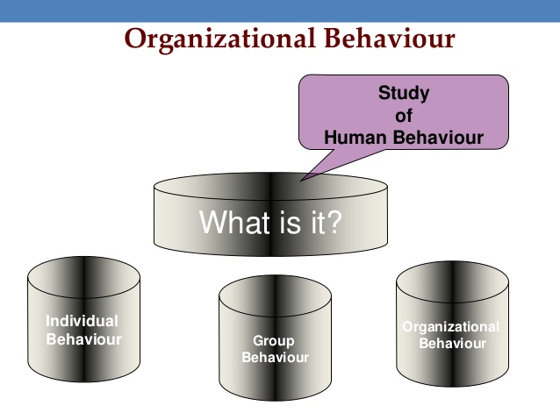

Slide 5
Organizational behavior- Meaning
The definitions on OB are many. However, three features need to be emphasized in any definition:
• OB is the study of human behaviour;
• The study is about behaviour in organizations; and
• Knowledge about human behaviour would be useful in improving an organization‘s effectiveness.
OB –Human side of Management

Slide 6
Introduction
The value system, emotional intelligence, organizational culture, job design and the work environment are important causal agents in determining human behaviour.

Slide 7
Organisational behaviour
‘Organizational Behaviour’ – It has two words ‘organisation’ and ‘Behaviour’.
What is an organization?
The term organization is defined as two or more individuals who are interacting with each other within a deliberately structured set up and working in an interdependent way to achieve some common objective/s.
What is Behaviour?
“the way in which an individual or person behaves & response to a particular situation or stimulus.”

Slide 8
Definitions
―Organisational behaviour is a subset of management activities concerned with understanding, predicting and influencing individual behaviour in organisational setting.
— Callahan, Fleenor and Kudson
Organizational behavior is directly concerned with the understanding, prediction, and control of human behavior in organizations.” — Fred Luthans.

Slide 9
Definition
―Organisational behaviour is a field of study that investigates the impact that individuals, groups and structure have on behaviour within the organisations for the purpose of applying such knowledge toward improving an organization‘s effectiveness.
—Stephens P. Robbins.
In short, organisational behaviour revolves around two fundamental components:
1. The nature of the Human being/man. 2. The nature of the organisation

Slide 10
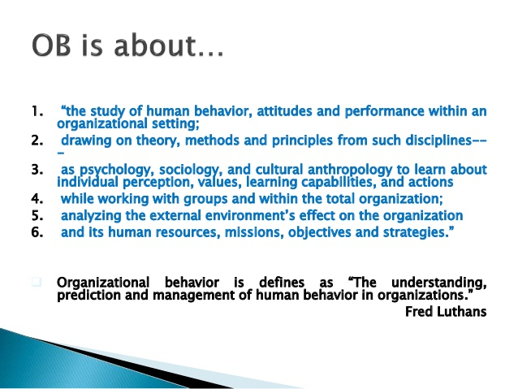

Slide 11
OB studies ……
What people do in an organization
How their behavior effects the overall performance of the organization.
Behavior related to concerns: such as absenteeism, turnover, productivity etc.
Includes the core work determinants (motivation, leadership, power, politics, conflict etc..).

Slide 12
Characteristics of Organisational Behavior
Behavioural Approach to Management:
Cause and Effect Relationship:
Three Levels of Analysis-individual behaviour, inter-individual behaviour and the behaviour of organisations
A Science as well as an Art
A Body of Theory, Research and Application
Beneficial to both Organisation and Individual

Slide 13
OB works at three levels
OB
Individual
Group
Organization
Source : Stephen Robbins

Slide 14
Assumptions
The basic assumptions distinct to the discipline are
• There are differences between individuals.
• A whole person.
• Behaviour of an individual is caused.
• An individual has dignity.
• Organizations are social systems.
• Mutuality of interest among organizational members . .
• Holistic organizational behaviour.
• Need for Management.

Slide 15
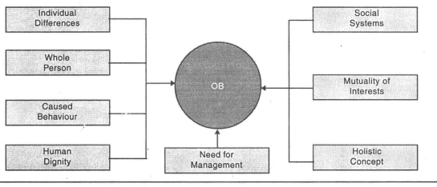
FOUNDATIONS OF OB

Slide 16
Key forces affect Organizational Behaviour
People
Structure
Technology
Job
Process
Environment

Slide 17
Characteristics of the Field of OB
OB applies the scientific method to practical managerial problems
OB focuses on three levels of analysis: individuals, groups, and organizations
OB is multidisciplinary in nature
OB seeks to improve organizational effectiveness and the quality of life at work

Slide 18
Organizational Behavior is
A Separate Field of Study and not a Discipline Only.
An Interdisciplinary Approach.
Applied Science.
Normative Science.
A Humanistic and Optimistic Approach.
A Total System Approach

Slide 19
Why does OB Matter
Companies whose managers accurately appraise the work of their subordinates enjoy lower costs and higher productivity
People who are satisfied with the way they are treated on their jobs are more pleasant to work with and less likely to quit
People who are trained to work together tend to be happier and more productive
Employees who believe they have been treated unfairly are more likely to steal and reject the policies of their organizations
People who are mistreated by their supervisors have more mental and physical illnesses than those who are treated with kindness, dignity, and respect
Organizations that offer good employee benefits and have friendly conditions are more profitable than those that are less people oriented

Slide 20
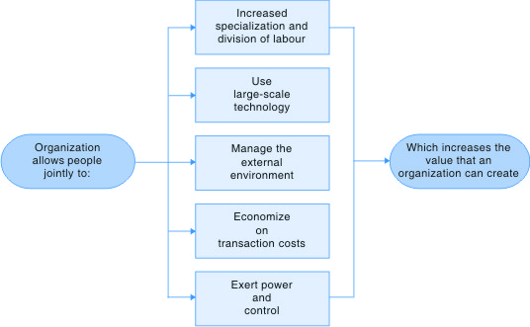
Five Reasons Why Organizations Exist

Slide 21
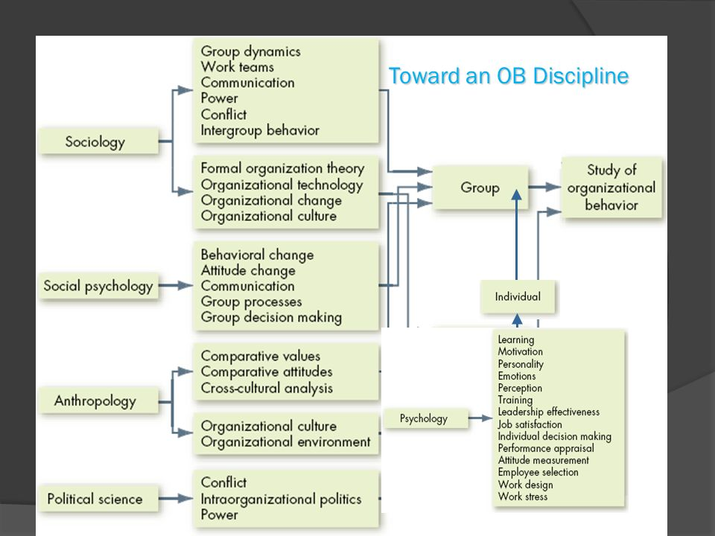
Contributing Disciplines to the OB Field

Slide 22
Importance of OB
Road map to our lives in organisations
Helps us understand and predict organisational life
Influences events in organisations
Helps understand self and others better
Helps a manager get things done better
Helps maintain cordial relations
Highly useful in the field of marketing
Helps in career planning and development
Helps sustain the temp of economic growth

Slide 23
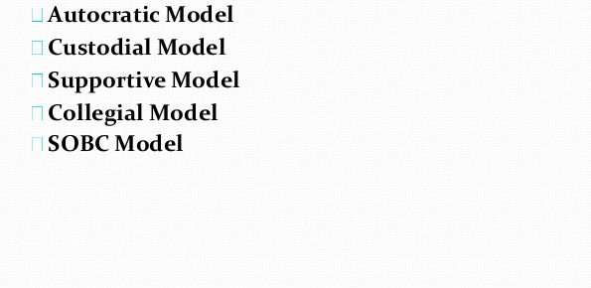
Models of OB

Slide 24
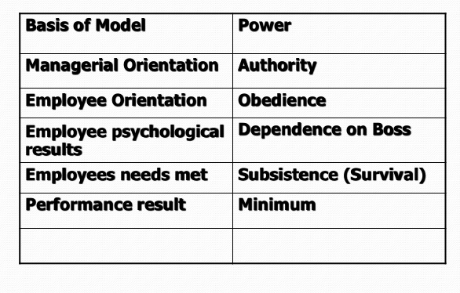
Autocratic Model

Slide 25
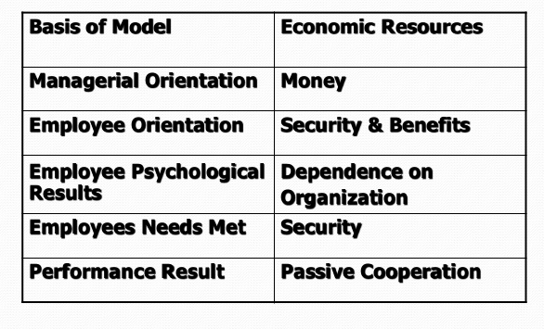
Custodian Model

Slide 26
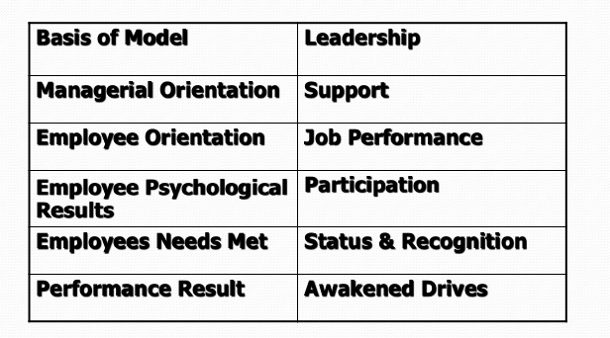
Supportive Model

Slide 27
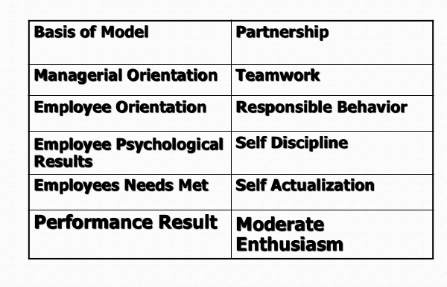
Collegial Model

Slide 28
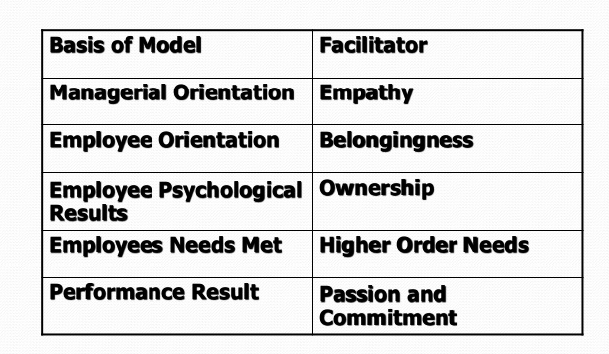
SOBC Model Stimulus Organism-Behaviour-Consequences

Slide 29
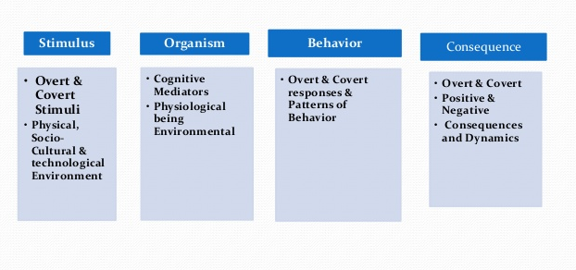
SOBC Model

Slide 30
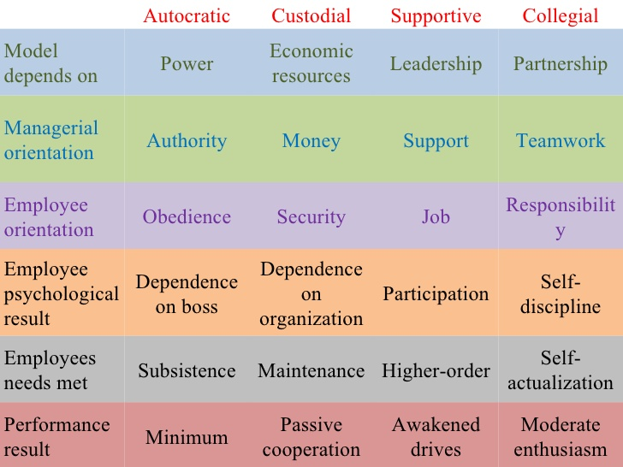
OB Models

Slide 31
Approaches of the study of OB
Human Resource Approach
Contingency Approach
System Approach
Productivity Approach
Internationalism

Slide 32
Three Good Reasons Why You Should Care About . . . Organizational Behavior
Understanding the dynamics of behavior in organizations is essential to achieving personal success as a manager, regardless of your area of specialization
Principles of organizational behavior are involved in making people both productive and happy on their jobs
To achieve success in today’s rapidly changing environment, organizations must successfully address a wide variety of OB issues
Notes:
2

Slide 33
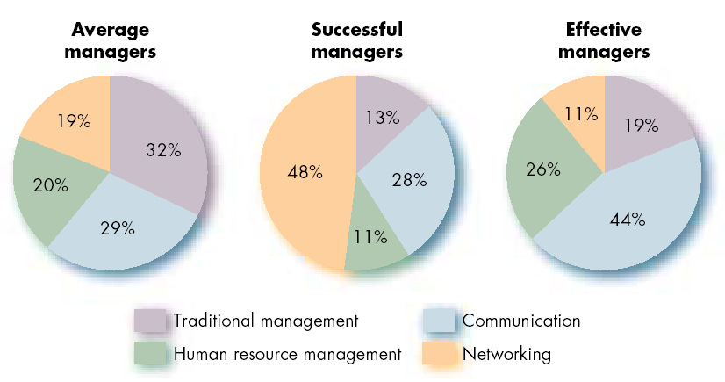
Allocation of Activities by Time

Slide 34
Challenges and Opportunities for OB
Responding to Globalization
Increased foreign assignments
Working with people from different cultures
Coping with anti-capitalism backlash
Overseeing movement of jobs to countries with low-cost labor
Outsourcing/ in-sourcing, off-shoring, multi-sourcing, open-sourcing, BPO, Call centers
Managing Workforce Diversity
Embracing diversity
Changing demographics of countries
Implications for managers
Recognizing and responding to differences

Slide 35
Challenges and Opportunities for OB (cont’d)
Improving Quality and Productivity
Quality management (QM)
Process reengineering
Responding to the Labor Shortage
Changing work force demographics
Fewer skilled laborers
Early retirements and older workers
Improving Customer Service
Increased expectation of service quality
Customer-responsive cultures

Slide 36
Improving Quality and Productivity
Quality management (QM)
The constant attainment of customer satisfaction through the continuous improvement of all organizational processes.Requires employees to rethink what they do and become more involved in workplace decisions.
Process reengineering
Asks managers to reconsider how work would be done and their organization structured if they were starting over.Instead of making incremental changes in processes, reengineering involves evaluating every process in terms of its contribution.

Slide 37
Thank YOU

Slide 38
https://slideplayer.com/slide/8011103/

